Slide 1
CPU Scheduling

Slide 2
Process Scheduling
The process scheduling is the activity of the process manager that handles the removal of the running process from the CPU and the selection of another process on the basis of a particular strategy.
Process scheduling is an essential part of Multiprogramming operating systems.
In a single Processor system, only one process can run at a time; any other must wait until the CPU is free and can be rescheduled.
The Objective of Multiprogramming is to have some process running at all times to maximize the CPU utilization.

Slide 3
Dispatcher
Another component involved in the CPU scheduling function is the Dispatcher.
The dispatcher is the module that gives control of the CPU to the process selected by the short-term scheduler.
This function involves:
  Switching context
  Switching to user mode
  Jumping to the proper location in the user program to restart that program from where it left last time.

Slide 4

Type of CPU Scheduling
CPU scheduling decisions may take place under the following four circumstances:
When a process switches from the running state to the waiting state (for I/O request or invocation of wait for the termination of one of the child processes).
When a process switches from the running state to the ready state (for example, when an interrupt occurs).
When a process switches from the waiting state to the ready state (for example, completion of I/O).
When a process terminates.

Slide 5
Type of CPU Scheduling
In circumstances 1 and 4, there is no choice in terms of scheduling. A new process (if one exists in the ready queue) must be selected for execution. There is a choice, however in circumstances 2 and 3.
When Scheduling takes place only under circumstances 1 and 4, we say the scheduling scheme is Non-preemptive; otherwise the scheduling scheme is Preemptive.
Running to Waiting
Running to Ready
Waiting to Ready
Process Terminate

Slide 6
Type of CPU Scheduling
Non-Preemptive Scheduling
Under non-preemptive scheduling, once the CPU has been allocated to a process, the process keeps the CPU until
Process is terminated
Switches to the waiting state.
Preemptive Scheduling
In this type of Scheduling, the process switches the control to another process in following conditions
High Priority Process Arrives
Times Slice Expires
Process completes it I/O Operation
Generate a child process

Slide 7
CPU Scheduling Criteria
Throughput: It is the total number of processes completed per unit time or rather say total amount of work done in a unit of time. This may range from 10/second to 1/hour depending on the specific processes.
Turnaround Time: It is the amount of time taken to execute a particular process, i.e. the interval from time of submission of the process to the time of completion of the process (Wall clock time).
TAT(CT-AT)
Waiting Time: The sum of the periods spent waiting in the ready queue amount of time a process has been waiting in the ready queue to acquire get control on the CPU. WT(TAT-BT)

Slide 8
CPU Scheduling Criteria cont…
Load Average: It is the average number of processes residing in the ready queue waiting for their turn to get into the CPU.
Response Time: Amount of time it takes from when a request was submitted until the first response is produced. Remember, it is the time till the first response and not the completion of process execution (final response).
In general CPU utilization and Throughput are maximized and other
factors are reduced for proper optimization.
CPU Utilization: To make out the best use of CPU and not to waste any CPU cycle, CPU would be working most of the time (Ideally 100% of the time).
Considering a real system, CPU usage should range from 40% (lightly loaded) to 90% (heavily loaded).

Slide 9

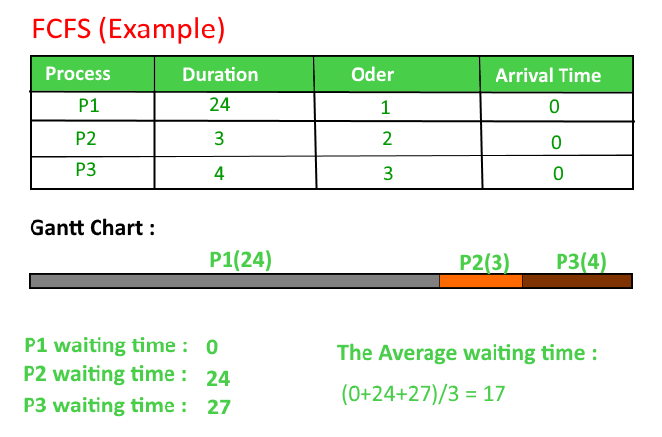
FCFS Example-Q1
Average WT=17

Slide 10
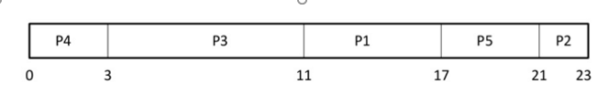
Q2
Process Burst time Arrival time
P1 6 2
P2 3 5
P3 8 1
P4 3 0
P5 4 4
Average WT=8

Slide 11
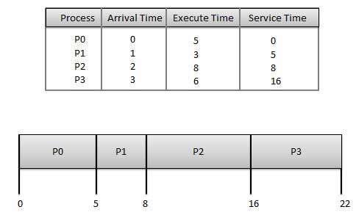
Q3
Average WT=5.75

Slide 12
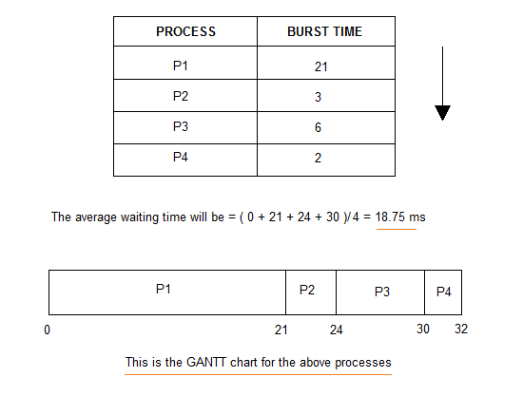
Q4.

Slide 13
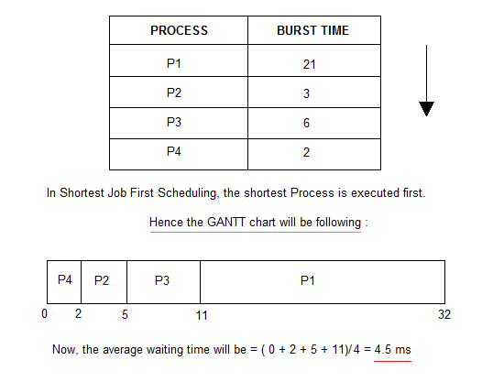
SJF

Slide 14
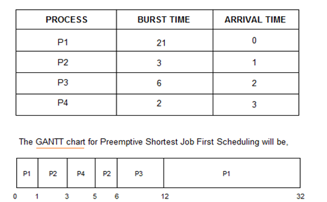
SJF with non-preemptive

Slide 15
Example 2(Non-preemptive)
Process Queue Burst time Arrival time
P1 6 2
P2 2 5
P3 8 1
P4 3 0
P5 4 4

Slide 16
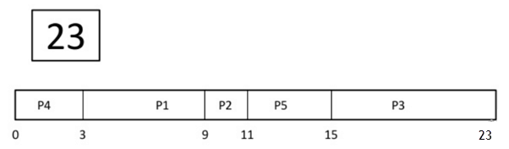
Wait time
  P4= 0-0=0
  P1= 3-2=1
  P2= 9-5=4
  P5= 11-4=7
  P3= 15-1=14
Average Waiting Time= (0+1+4+7+14)/5 = 26/5 = 5.2

Slide 17
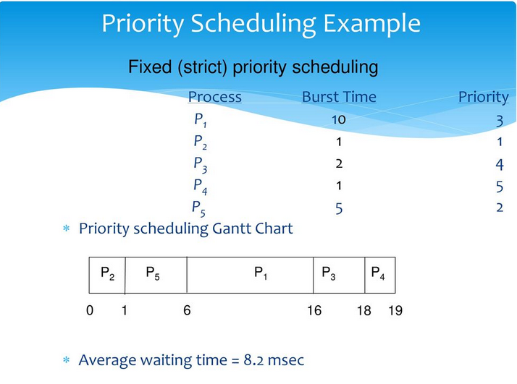

Slide 18
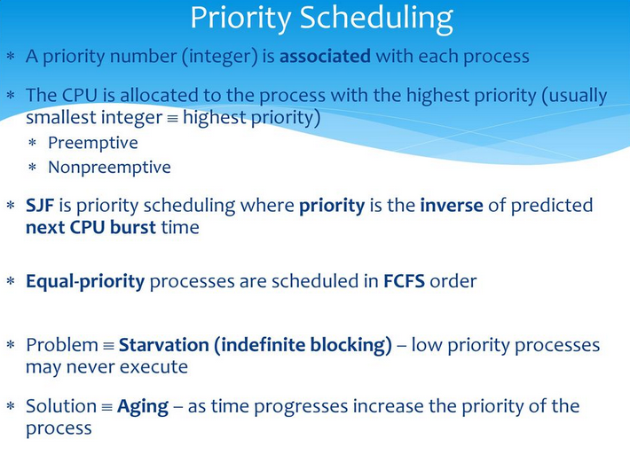

Slide 19
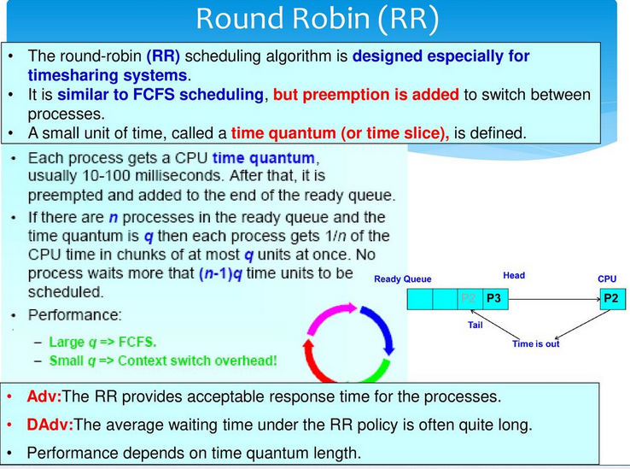

Slide 20
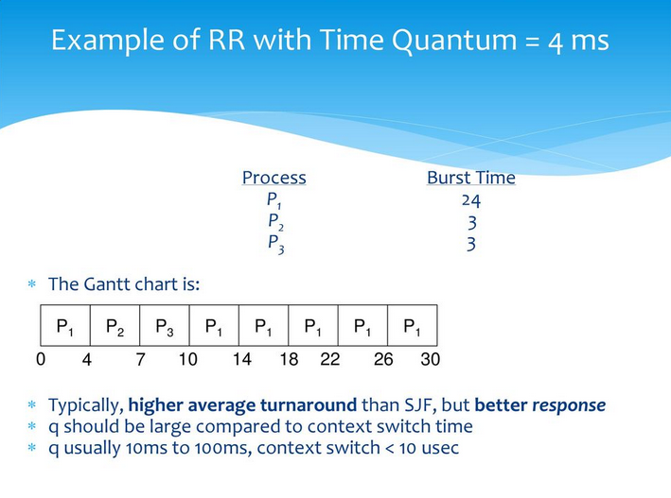

Slide 21
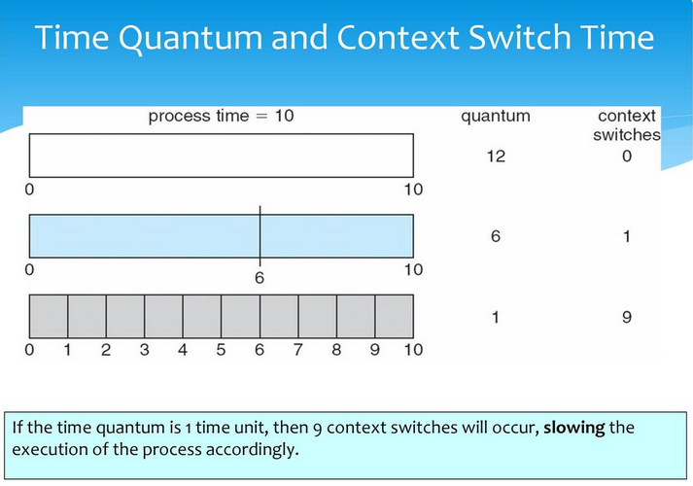

Slide 22


